Slide 1

Morbidity Indicators

Slide 2
Question - 1
In a community development block area with population of one lakh, there were 500 cases of TB and 5 cases of rabies during 2006. During the same year there were a total of 250 deaths, out of which 5 were due to rabies and 50 due to TB.
Calculate the CDR.
Calculate separately for TB and rabies the cause-specific mortality rate (CSMR),
CFR
PMR.

Slide 3
Answer
CDR = 2.5 per 1000;
CSMR: TB 0.5/1000, rabies 0.05/1000;
CFR: TB 10%, rabies 100%;
PMR: TB 20%, rabies 2%

Slide 4
Question 2
In a state during 2007, approximately 10% of all deaths in the age group of 0-14 years were due to accidents and injuries, while in the age group of 15-35 years, 20% of all deaths were due to accidents and injuries. How many times is the risk of dying due to accidents and injuries among 15-35 years as compared to 0-14 years?
4
1
0.5
2
Cannot be concluded from the data

Slide 5
Answer
Answer is (e). The % of deaths is actually PMRs (proportional mortality ratios) for the two age groups. The PMR gives the proportion of deaths that are due to a given cause out of the total deaths but does not give us the risk of dying due to that disease. The risk of death due to accidents and injuries in a particular age group would be given by the age and cause specific mortality rate

Slide 6
MCQ
The denominator in age-specific mortality rate (ASMR) for children aged up to 5 years wil be-
(a) Live births
(b) Mid-year population of entire community
(c) Mid-year population of children aged up to 5 years
(d) Deaths among children aged up to 5 years

Slide 7
mcq
In a particular year during which the mid- year population of India was 1000 million, the total deaths due to tuberculosis were 0.5 million, i.e., 0.5 deaths due to TB per 1000 population. This is the:
(a) Case fatality rate
(b) Cause-specific mortality rate
(c) Proportionate mortality ratio
(d) Incidence of morbidity due to TB

Slide 8
mcq
A lady who was 28 weeks pregnant unfortunately died in a roadways bus accident. While calculating the MMR, she will be:
(a) Included in numerator
(b) Included in denominator
(c) Included in both numerator and denominator
(d) Will not be included either in numerator or in the denominator

Slide 9
Morbidity
Morbidity has been defined as “any departure, subjective or objective, from a state of physiological well-being”.
The term is used equivalent to such terms as sickness, illness, disability etc.
Measured in terms of 3 units -
Frequency (Incidence and prevalence)
Duration (Average duration per case or disability rate)
Severity (Case fatality rate)

Slide 10
Value of morbidity data
They describe the extent and nature of the disease load in the community, and thus assist in the establishment of priorities.
They usually provide more comprehensive and more accurate and clinically relevant information on patient characteristics, than can be obtained from mortality data, and are therefore essential for basic research.
They serve as starting point for aetiological studies, and thus play a crucial role in disease prevention.
They are needed for monitoring and evaluation of disease control activities.

Slide 11
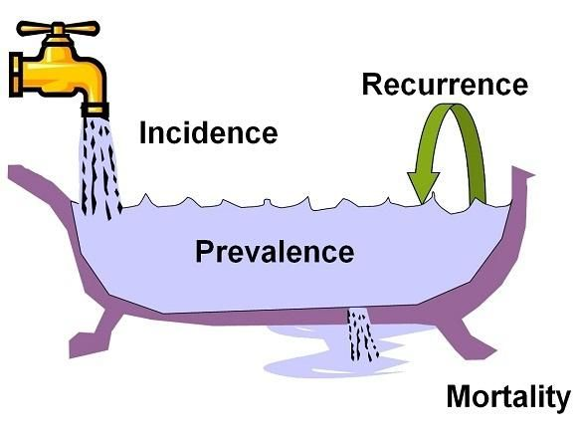
Incidence and prevalence
Mortality and Recover

Slide 12
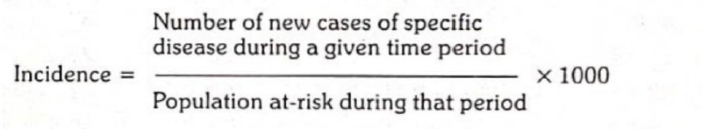
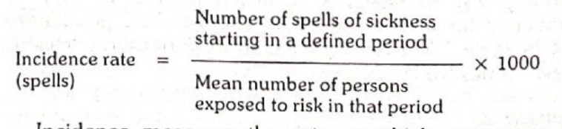
Incidence
The number of NEW cases occurring in a defined population during a specified period of time.
Refers to:
a. only to new cases
b. during a given period (usually one year)
c. in a specified population or “population at risk”, unless other denominators are chosen.
d. it can also refer to new spells or episodes of disease arising in a given period of time, per 1000 population. For example, a person may suffer from common cold more than once a year. If he had suffered twice, he would contribute 2 spells of sickness in that year
It is not influenced by the duration of the disease. The use of incidence is generally restricted to acute conditions.

Slide 13
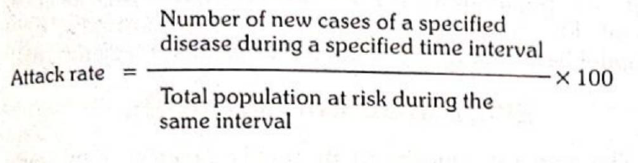
Special incidence rate
Attack rate
An attack rate is an incidence rate (usually expressed as a per cent), used only when the population is exposed to risk for a limited period of time such as during an epidemic. It relates the number of cases in the population at risk and reflects the extent of the epidemic.
Secondary attack rate
It is defined as the number of exposed persons developing the disease within the range of the incubation period following exposure to a primary case,

Slide 14
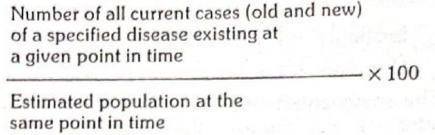
prevalence
Refers specifically to all current cases (old and new) existing at a given point in time, or over a period of time in a given population.
“The total number of all individuals who have an attribute or disease at a particular time (or during a particular period) divided by the population at risk of having the attribute or disease at this point in time or midway through the period”.
Although referred to as a rate, prevalence rate is really a ratio.
Types – Point Prevalence
Point prevalence of a disease is defined as the number of all current cases (old and new) of a disease at one point of time, in relation to a defined population. The point in Point prevalence, may for all practical purposes consist of a day, several days, or even a few weeks, depending upon the time it takes to examine the population sample
When the term “prevalence rate” is used, without any further qualification, it is taken to mean “point prevalence”.

Slide 15
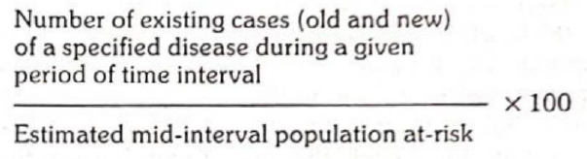
Period prevalence
A less commonly used measure of prevalence is period prevalence. It measures the frequency of all current cases (old and new) existing during a defined period of time (e.g., annual prevalence) expressed in relation to a defined population. It includes cases arising before but extending into or through to the year as well as those cases arising during the year.

Slide 16
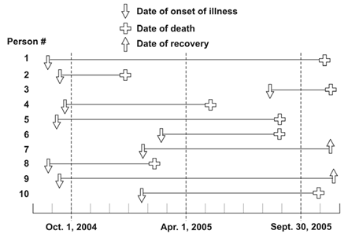

Slide 17
P = I * D (D = mean duration)
Mortality and Recover

Slide 18
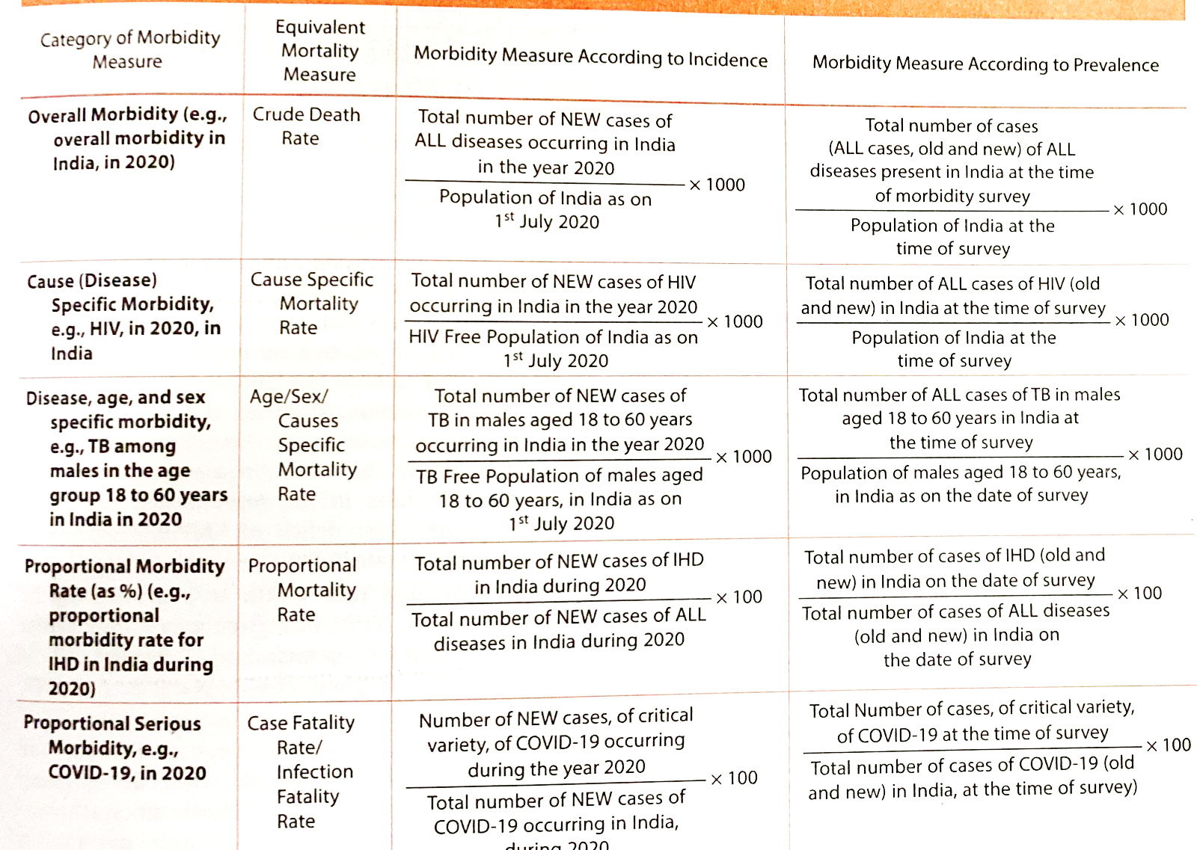

Slide 19
Measures of disability
One factor
Percentage of population who are not able to undertake "activities of daily living“
Percentage of population who are economically blind, according to different age groups
Percentage of population who have hearing impairment, according to different age groups
Percentage of population who have orthopedic disabilities
Percentage of population who are disabled due to leprosy or paralytic poliomyelitis
Composite Indicator
DALY (Disability adjusted life years)
Combines the effect of mortality and morbidity in a single index

Slide 20
DALY
One of the targets of SDG (Sustainable development goals) is to DALY as a worldwide indicator of disability.
DALY combines, in one measure, the time lived with disability and the time lost due to premature mortality.
Thus, DALY = "Years of Potential Life Lost" (YPLL) + "Years of Life Lost due to Disability"(YLD).
One DALY can be defined as "one lost year of’ healthy life, either due to premature death or living with disability due to diseases."

Slide 21
Other Indicators
Nutritional Indicator
Measures of fertility
Health services
Socio-economic
Summary measure of population health – PQLI, HDI
Health financing
Indicators of environmental health

Slide 22
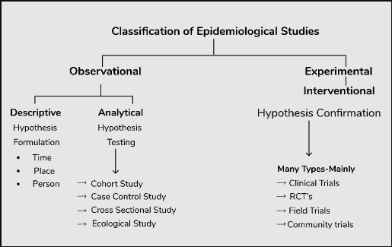

Slide 23
Descriptive study
Descriptive study is limited to a description of the occurrence of a disease in a population.
It is essential to have a clear definition of a case of the disease being investigated and of an exposed person.
First phase of an epidemiological investigation.
These studies are concerned with observing the distribution of disease or health-related characteristics in human populations and identifying the characteristics with which the disease in question seems to be associated.
When, Where and Who

Slide 24
Steps
1. Defining the population to be studied
2. Defining the disease under study
3. Describing the disease by
a. time
b. place
c. person
4. Measurement of disease
5. Comparing with known indices
6. Formulation of an aetiological hypothesis

Slide 25
Defining the population
Descriptive studies are investigations of populations, not individuals.
Define the “population base” not only in terms of the total number, but also its composition in terms of age, sex, occupation, cultural characters and similar information needed for the study.
The “defined population” can be the whole population in a geographic area, or more often a representative sample taken from it.
The defined population can also be a specially selected group such as age and sex groups, occupational groups, hospital patients, school children, small communities as well as wider groupings - in fact, wherever a group of people can be fairly accurately counted.

Slide 26
Defining the population
The defined population needs to be large enough so that age, sex and other specific rates are meaningful.
The community chosen should be stable, without migration into or out of the area.
Community participation must be forthcoming.
Population should not be overtly different from other communities in the region.
Health facility should be close enough to provide relatively easy access for patients requiring medical services.

Slide 27
Defining the population
The concept of ‘defined population’ (or population at risk) is crucial in epidemiological studies. It provides the denominator for calculating rates which are essential to measure the frequency of disease and study its distribution and determinants.
Epidemiologists therefore have been labelled as men in search of a denominator

Slide 28
Defining the disease
The clinician may not need a precise definition of disease (e.g., migraine) for immediate patient care. If the diagnosis is wrong, he can revise it subsequently.
Epidemiologist, whose main concern is to obtain an accurate estimate of disease in a population, needs a definition that is both precise and valid to enable him (or observers working in field conditions) to identify those who have the disease from those who do not.
The diagnostic methods for use in epidemiological studies must be acceptable to the population to be studied, and applicable to their use in large populations.

Slide 29
Operational definition
A definition by which the disease or condition can be identified and measured in the defined population with a degree of accuracy.
Tonsillitis might be defined clinically as an inflammation of the tonsils caused by infection, usually with streptococcus pyogenes.
An “operational definition” spells out clearly the criteria by which the disease can be measured. Such criteria in the case of tonsillitis would include the presence of enlarged, red tonsils with white exudate, which on throat swab culture grow predominantly S. pyogenes.
If the definition is not valid, it would be a powerful source of error in the presentation and comparability of measurements from different sources.
Certain diseases (e.g., neurological diseases) which often do not have pathognomonic signs and symptoms, disease definition is a crucial concern for the epidemiologist. In such cases, the epidemiologist frames his own definition keeping the objectives of his study in view and aiming at the same time a degree of accuracy sufficient for his purpose.
Once established, the case definition must be adhered to throughout the study.

Slide 30
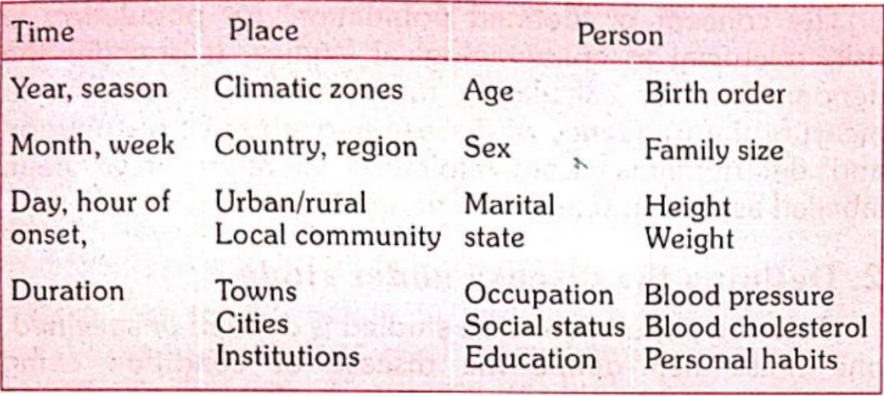
Describing the disease
The primary objective of descriptive epidemiology is to describe the occurrence and distribution of disease (or health-related events or characteristics within populations) by time, place and person, and identifying those characteristics associated with presence or absence of disease in individuals.

Slide 31

Thanks

